Slide 1

An analysis of Guns & Crime
By Christian Lopez

Slide 2
The Original Model
Guns_and_Crime.csv consisted of the following:
Independent Variables – ID, Year, prisoners, Afam (African-American Population), Cauc, Male, Population, Income, Density, State, and Law
Dependent Variable - Crime

Slide 3
Model Modifications #1: Variables
Removed ID – Was just Observation # duplicate
Created dummyLaw – As Law holds categorical values
dummyLaw = 0, means Law = No
dummyLaw = 1, means Law = Yes
Removed State – Holds categorical values
Would Require 51 dummy variables

Slide 4
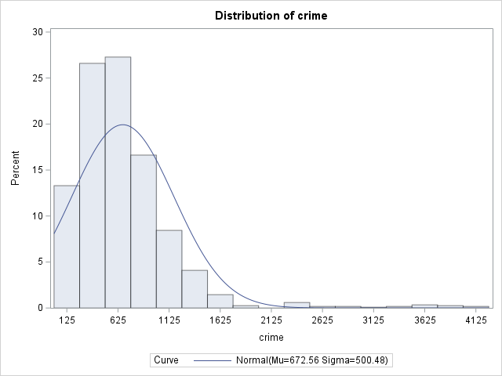
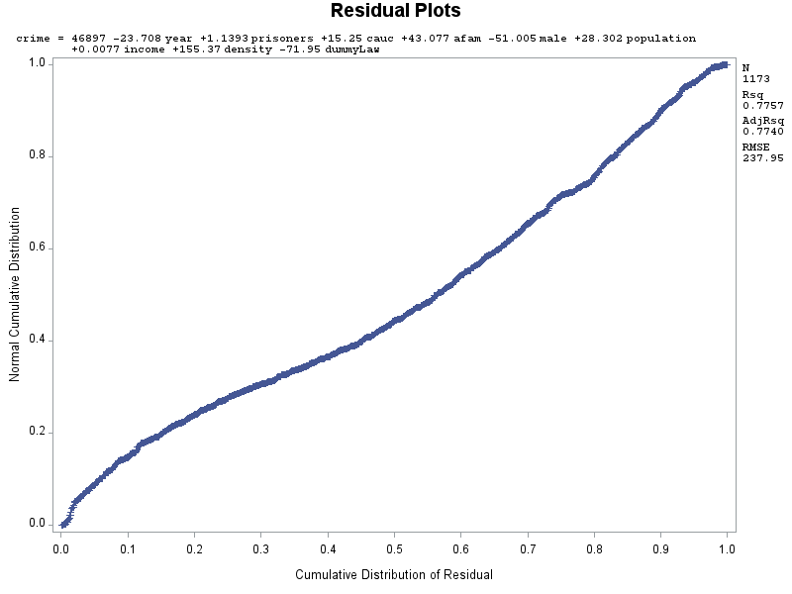
Full Model Output
Histogram Issues:
Has a right-hand tail
Not centered
Outliers towards the right
Normal Probability Plot has a decent shape
Has normality

Slide 5
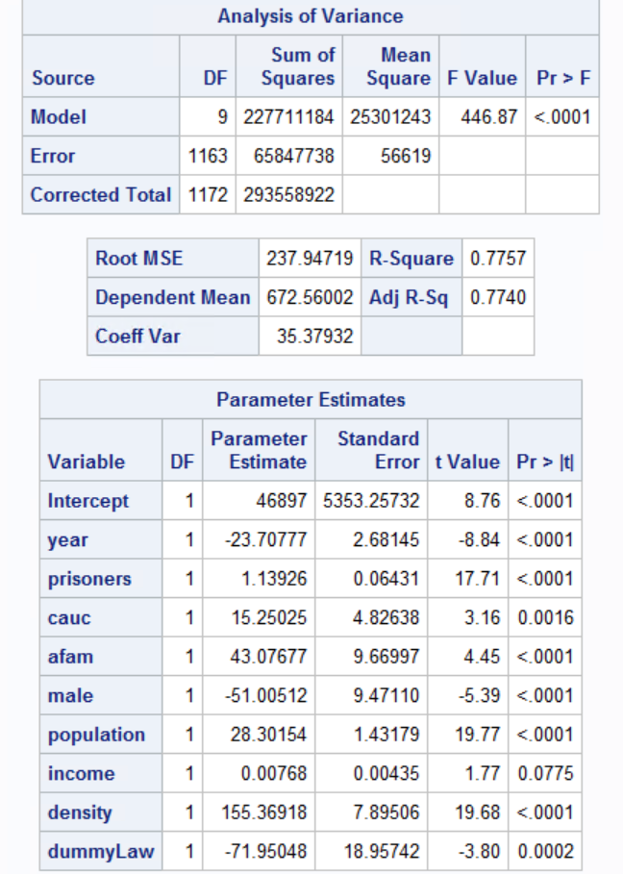
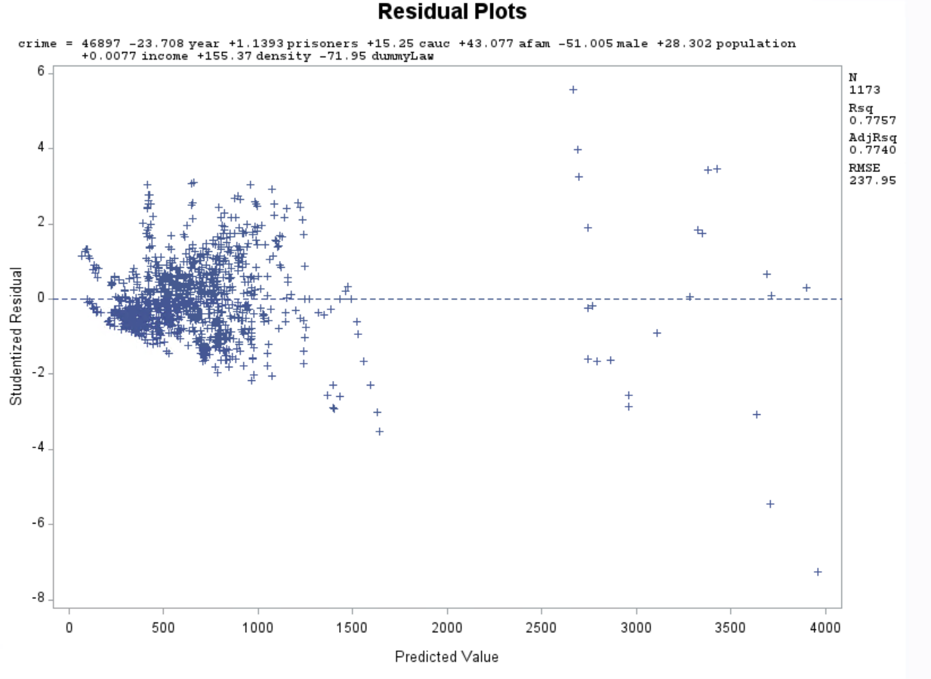
Full Model Output: Continued
Student Residual Plot:
Has a funnel Shape
No Constance variance, nor independence
Random Pattern – Has Linearity
Has outliers
Regression Model:
Has a High F Value (446.87)
Good R^2 (0.7757) and ADJ R^2 (0.7740)
All Dependent variables have good P-Values
Note: Scatter Plot Matrix also showed no linearity

Slide 6
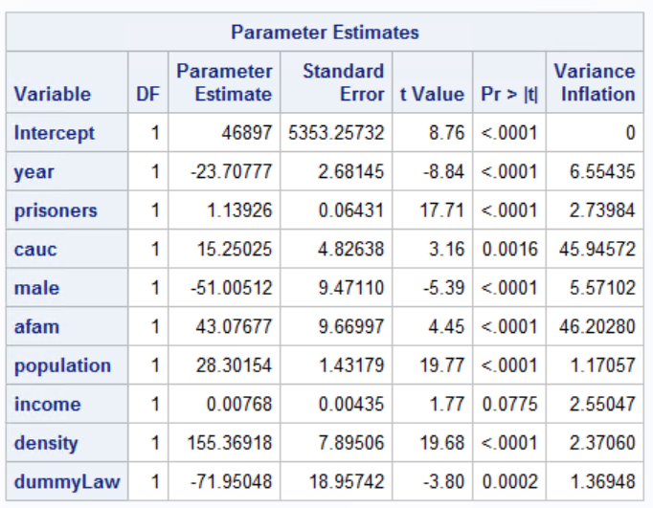
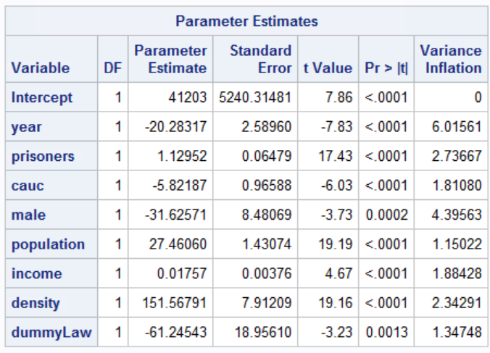
Model Modifications #2: Multicollinearity
Full Model:
Both Cauc and afam have a VIF > 10
After Removing afam:
All VIF’s < 10

Slide 7
Model Modifications #3: Outliers and Influential Points
17 observations in total removed
I removed and re-ran the model with the following order of deletion:
Observation 207, 206, 189, 189, 203, 188, 115, 1005, 1004, 114, 1002, 1001, 727, 640, 640, 730, and 996
Either these values had a large studentized residual > ± 3
And/Or an Influential Point with an arrowhead
Afterwards there were no outliers
Some influential points had arrowheads, but I decided to leave them

Slide 8
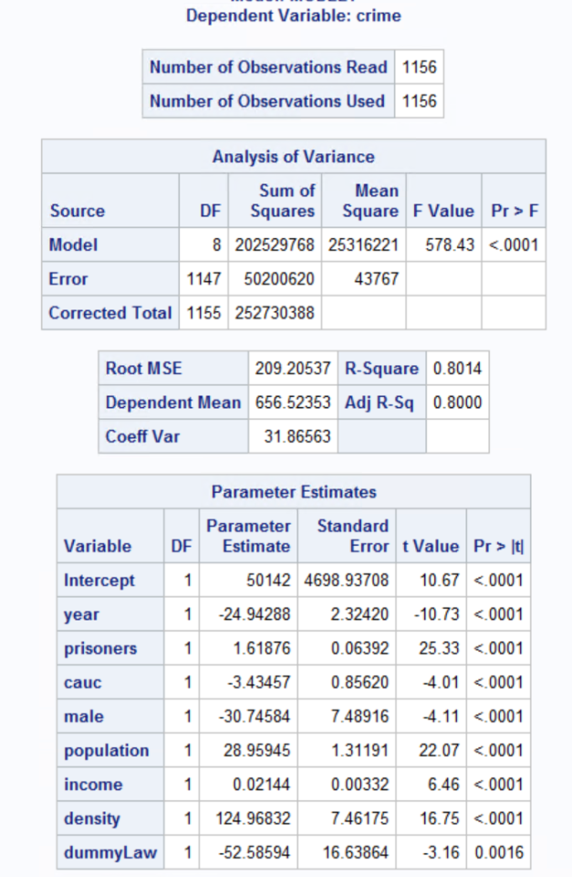

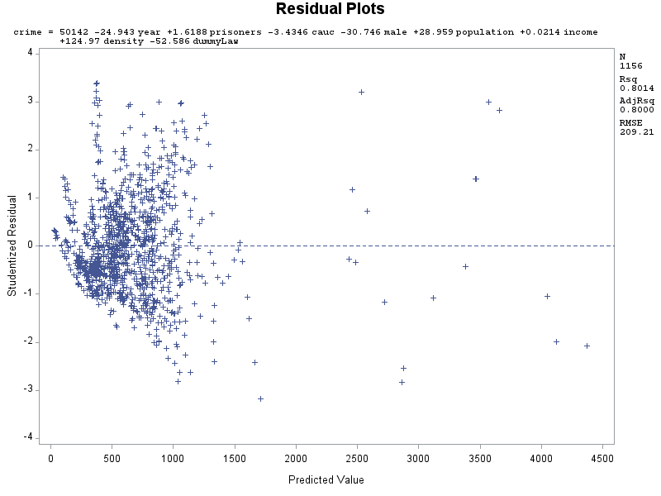
Looking at updated outputs
Essentially unchanged
Funnel shape still
F-value increased
R^2 and ADJ R^2 increased

Slide 9
Model Modifications #4: Transformation
I created the variable sqrtCrime, which is Crime^2
I chose Square Root as the transformation as Crime rate can be >= 0
sqrtCrime is now the dependent variable

Slide 10
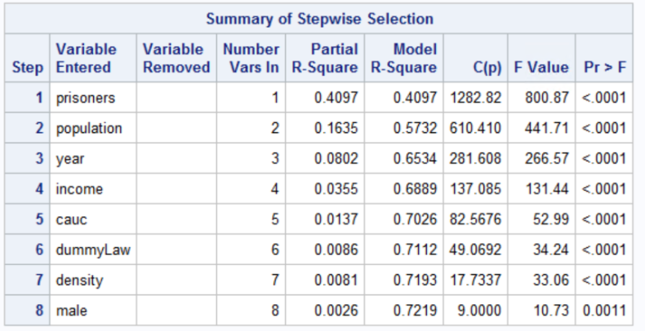
Model Modifications #5: Model Selection
Stepwise Model removed no variables

Slide 11
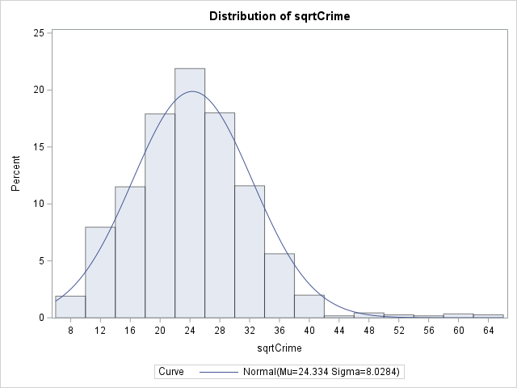
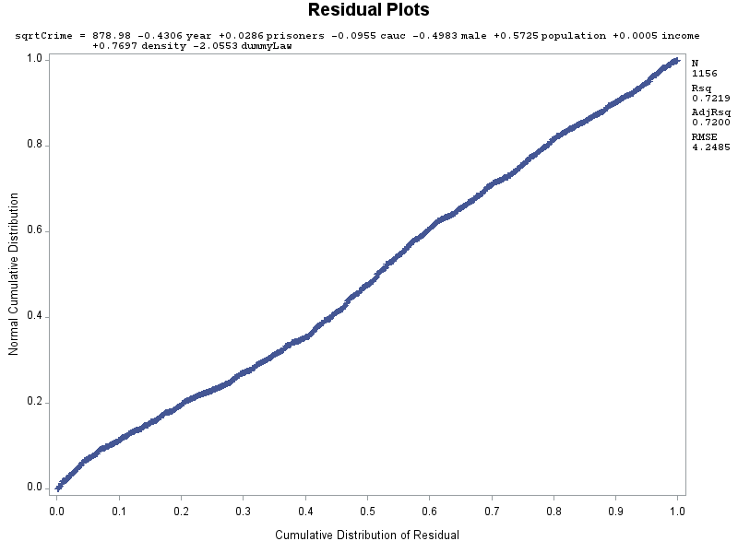
Final model with sqrtCrime
Histogram improved
Shifted closer towards the center
Tail shortened
Normal Probability Plot improved:
Has an even straighter line
With confidence, can claim normality

Slide 12
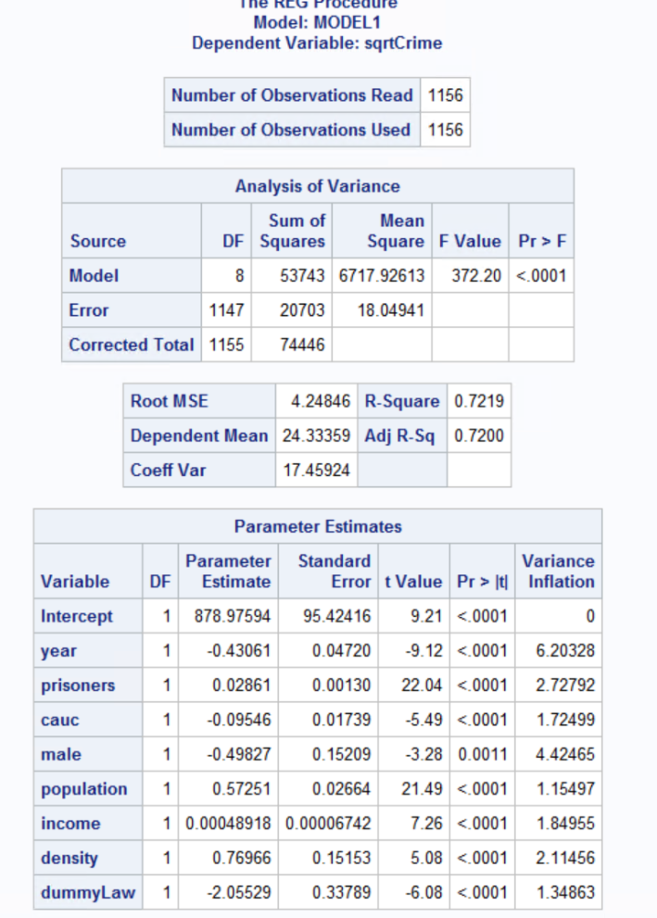
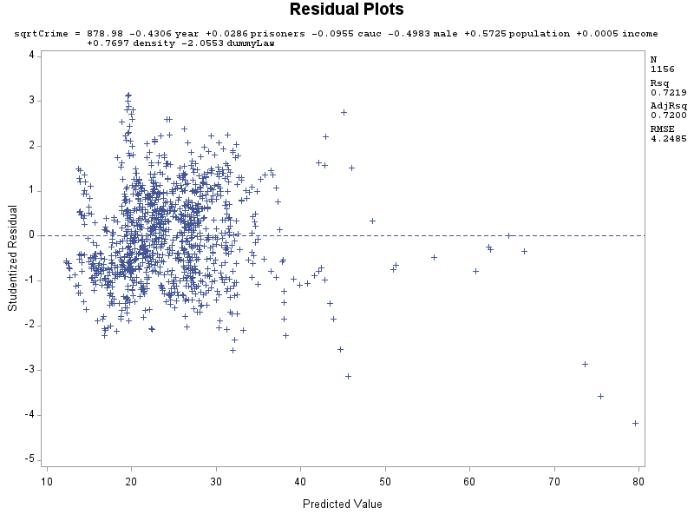
Final model with sqrtCrime: continued
Studentized Residual Plot improved:
Doesn’t have a funnel shape
Has Constant variance
Independent
Linearity
R^2 and ADJ R^2 slightly decreased
F-Value slightly decreased
No Multicollinearity
All variables are significant
Outliers removed

Slide 13
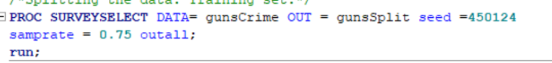
Data Split
Overall, satisfied with my final model
Next: A split by 75/25

Slide 14
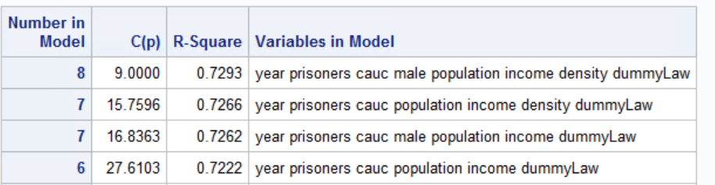
Training Set
Ran two model selections
Stepwise (result is same as final model)
CP:
I decided to use the model with 6 variables
Density and Male do not add much value into R-square
Model 1: sqrtCrime = year prisoners cauc male population income density dummyLaw
Model 2: sqrtCrime = year prisoners cauc population income dummyLaw

Slide 15
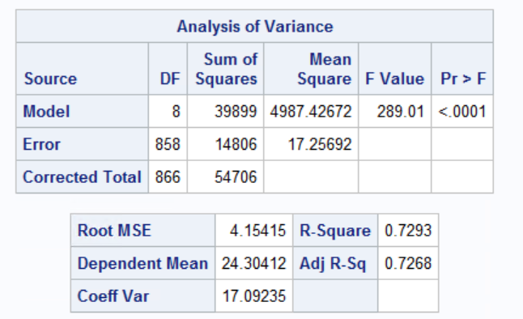
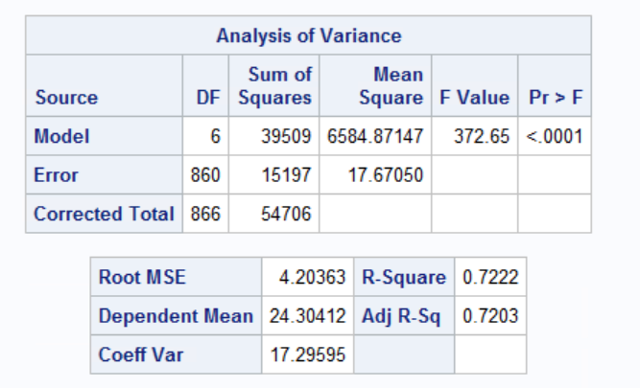
Training Set comparisons
Model 1
Model 2
Model 1 Pros:
R-Square is slightly better
Adjusted R-square is slightly better
Root MSE is slightly lower (Good)
Model 1 Cons:
Significantly worse F-Value
Uses more variables
I’d claim Model 2 is better:
Less variables
When it loses comparisons, its only slightly

Slide 16
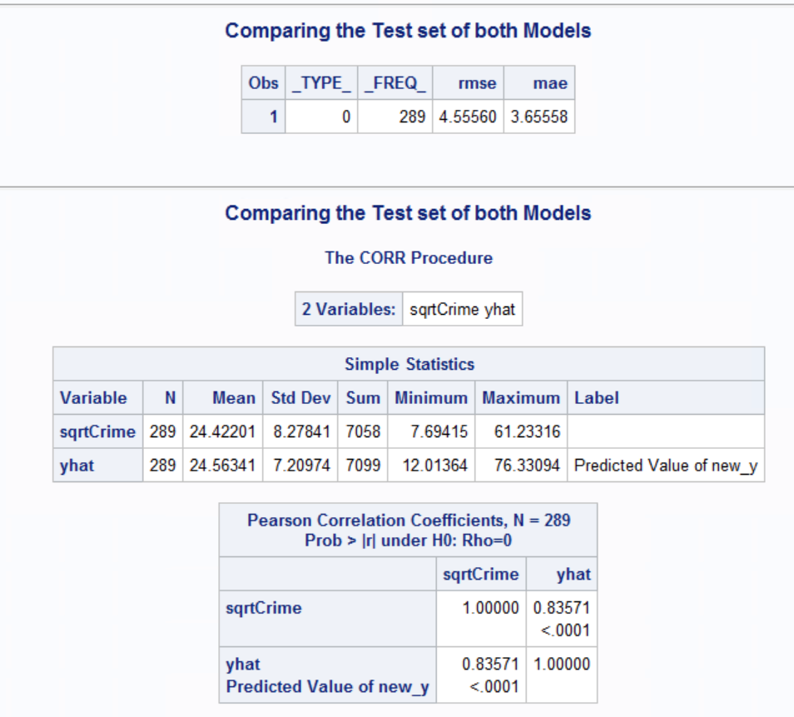
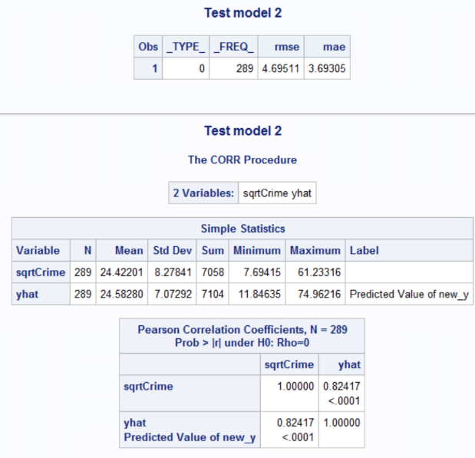
Testing Set comparisons
Model 1
Model 2
Model 1 Cross Validated R^2:
R^2 train = 0.7293
R^2 test = 0.83571 ^ 2
Absolute difference = 0.0309
Model 2 Cross Validated R^2:
R^2 train = 0.7222
R^2 test = 0.82417 ^ 2
Absolute difference = 0.0429
Overall both models are good
Model 1 slightly better
Still, Model 2 has less variables

Slide 17
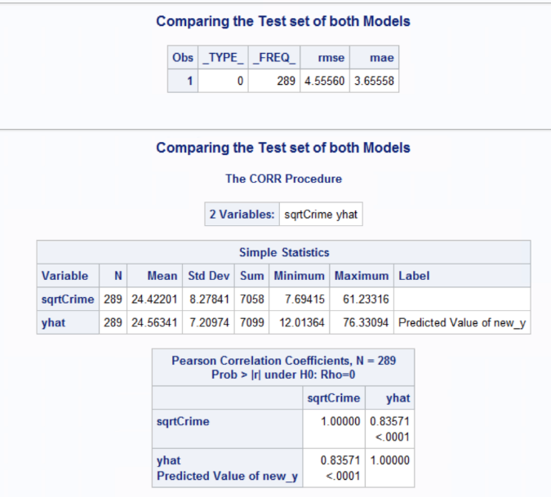

Training vs Test: Model 1
Training
Test
RMSE is better in Training Set
R^2 is better in Training
Note: Test R^2 is 0.698
Model 1 Training Set is slightly better
Not a good sight, Test should be better

Slide 18

Training vs Test: Model 2
Training
Test
RMSE is better in Training Set
R^2 is better in Training
Note: Test R^2 is 0.679
Model 2 Training Set is slightly better
Not a good sight, Test should be better
Still, moving forward will use Model 2

Slide 19
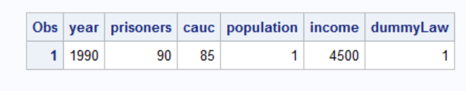
Predictions #1:
What is the crime rate of the following:
The Year is 1990, Prisoner incarceration rate is 90%, percent of state population that is Caucasian = 85%, Population is 1 million, real per capital personal income is $4,500, and the state has a shall carry law in effect?

Slide 20
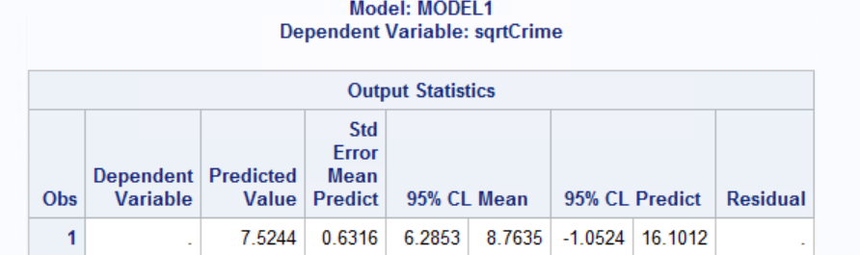
Predictions #1: Continued
Values Transformed
Predicted Crime Rate: 7.5244^2 = 56.62%
95% Confidence Interval: 6.2853^2 = 39.5% and 8.7635^2 = 76.8%
95% Prediction interval: -1.0524^2 = -1.11% and 16.1012^2 = 259.21%

Slide 21
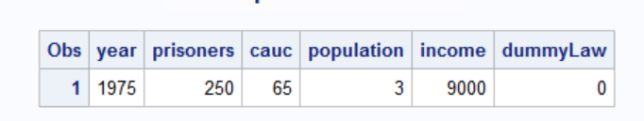
Predictions #2
What is the crime rate of the following:
The Year is 1975, Prisoner incarceration rate is 250%, percent of state population that is Caucasian = 65%, Population is 3 million, real per capital personal income is $9,000, and the state doesn’t have a shall carry law in effect?

Slide 22
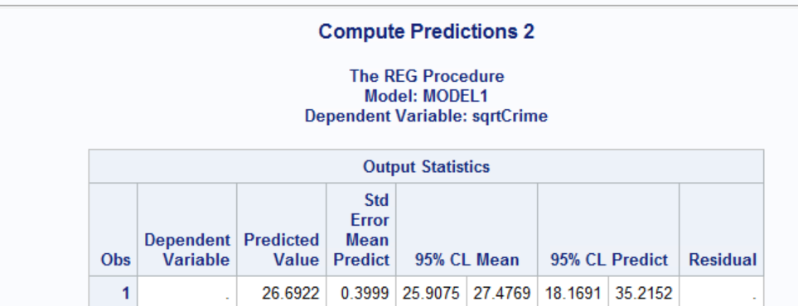
Prediction #2: Continued
Values Transformed
Predicted Crime Rate: 26.6922^2 = 712.47%
95% Confidence Interval: 25.9075^2 = 671.2% and 27.4769^2 = 754.98%
95% Prediction interval: 18.1691^2 = 330.12% and 35.2152^2 = 1240.11%

Slide 23
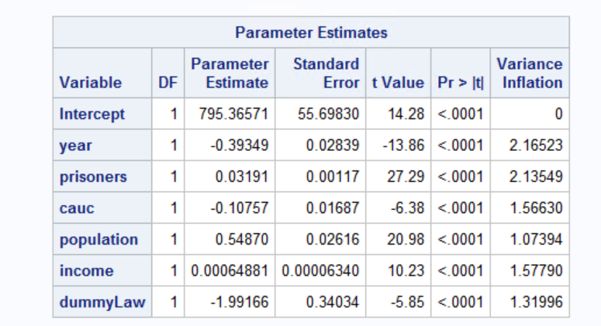
Final Regression Model
sqrtCrime = -0.39349^2 * year + 0.0319^2 * prisoners + 0.01687^2 *cauc + 0.54870^2 *population + 0.00064881^2 *income + -1.99166^2 * dummyLaw
All equally significant
Assuming all other variables are fixed…
A shall carry law (dummyLaw = 1) and a higher year will decrease crime rate
Alternatively, an increase in Prisoner incarceration rate, Caucasian population, income, and population will increase the crime rate.
This explains the dramatic changes between Prediction 1 and Prediction 2

Slide 24
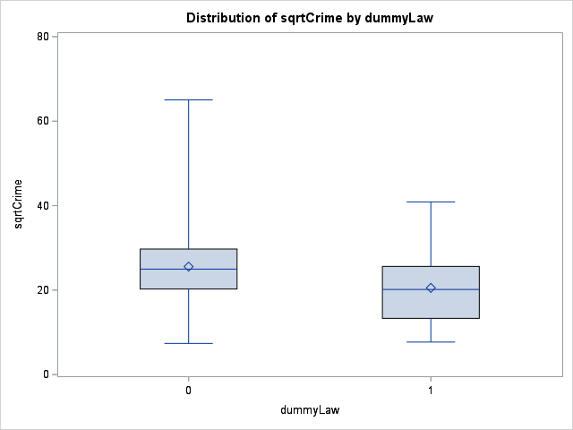
More Context
sqrtCrime = -0.39349^2 * year + 0.0319^2 * prisoners + 0.01687^2 *cauc + 0.54870^2 *population + 0.00064881^2 *income + -1.99166^2 * dummyLaw
Might prefer to live in a place with shall carry law
Recognize that as population increases, so will crime
Put these other variables into consideration as well

Slide 25
Overall
I’m satisfied with my model
There is room for improvement
Can improve R^2 and F-Value
Maybe use a different transformation
Testing should be > Training

